Slide 1



Introduction to
Python
Notes:
Cara

Slide 2


Instructor: Ruth Gittens
Welcome!
Session 1

Slide 3
Overview
Development Environment
Using Anaconda and Jupyter
Running Python Code
Agenda

Slide 4
What is programming?
Why write code?
What is a programming language?
What is data?
Overview

Slide 5
What is an Integrated Development Environment (IDE)?
Desktop vs Web-based Environments
Getting Setup
Development Environments

Slide 6
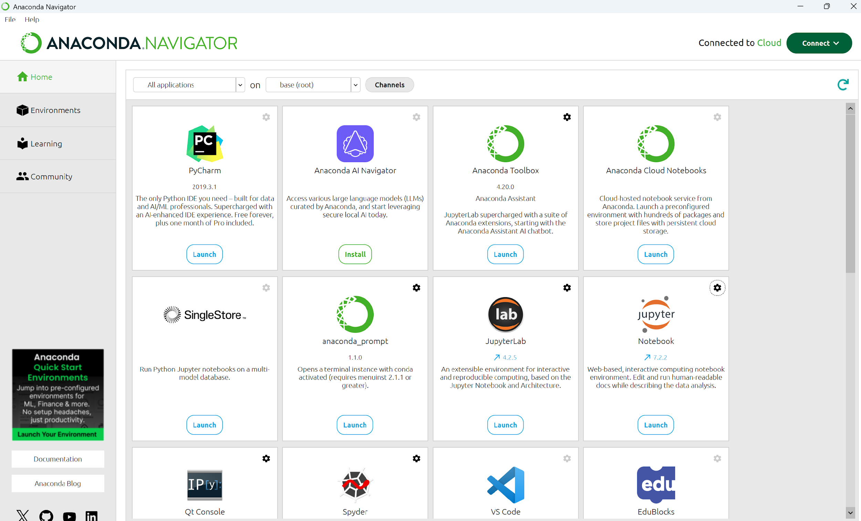
Anaconda
Notes:
Package manager
Locates and installs requested software: Large collection of packages

Slide 7
Launch the Anaconda Navigator on your desktop.
Hands-On

Slide 8
Web-based interactive development environment.
Data Science
Scientific computing
Scripting
Programming
JupyterLab
Notes:
Wait for the instructor to guide you through launching the lab.

Slide 9
Main documents are Jupyter notebooks
Notebooks can be shared
Used to create software libraries
JupyterLab
Notes:
Wait for the instructor to guide you through launching the lab.

Slide 10
Features that support collaborative editing
Supports Python (and other languages)
Jupyter Notebook
Notes:
Wait for the instructor to guide you through launching the lab.

Slide 11
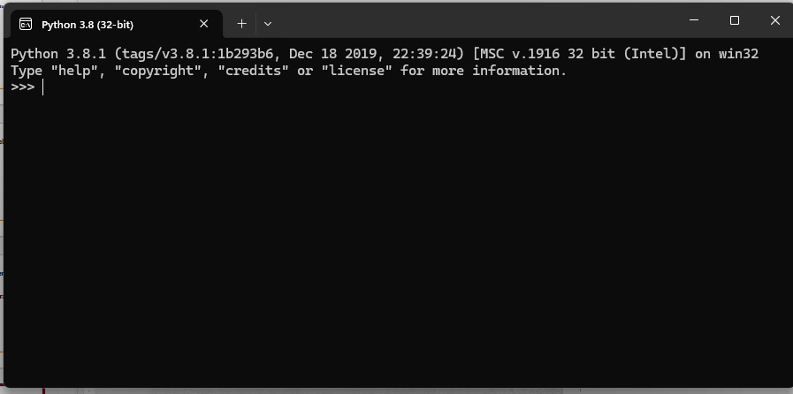
Python
Notes:
This is the Python interactive “terminal”. You could create code here, but it is difficult to share with explanations, hence leading to Jupyter Notebooks (earlier versions like Mathmatica existed)

Slide 12
Training
Scripting
Data visualization
Data Science Driven
JupyterLab & Python
Notes:
There are other tools you can use for coding… Visual Studio Code, PyCharm, IDLE…

Slide 13
Launch JupyterLab from your Anaconda Browser
HANDS-ON:
Notes:
Instructor will guide you through Launching JupyterLab

Slide 14
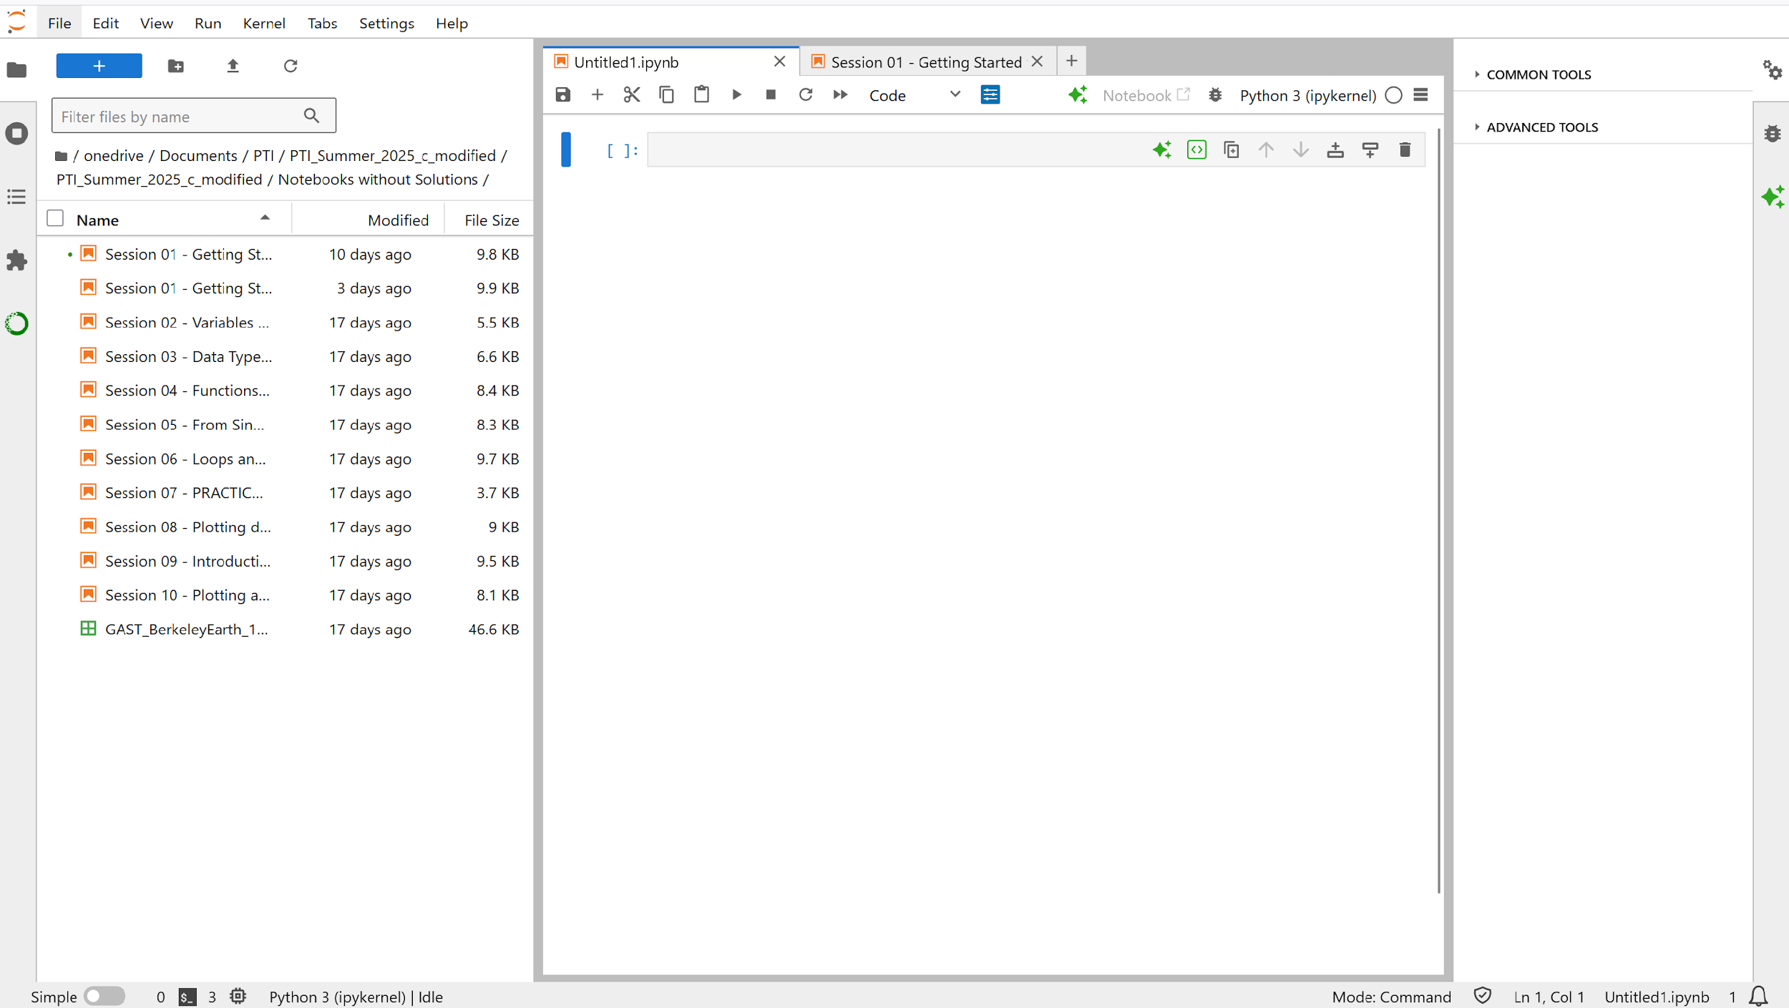
JupyterLab Interface
Notes:
Instructor will guide you through Launching JupyterLab
We will review:

Slide 15
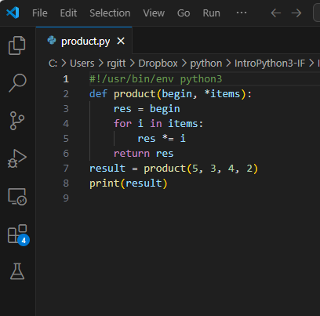
Python Script
Example
Notes:
Instructor will guide you through Launching JupyterLab

Slide 16
Working with Jupyter notebook
Hands-On
Notes:
Working with Jupyter Notebook.

Slide 17
Break
CFR students, please be back by 11 AM

Slide 18
Questions

